Slide 1

Software Engineering Module
Ridwan Abdurahman,
Abbas Hersi,
Abdul Omar,
Abdi Farah,
Abdi Moalin

Slide 2
Code of conduct
Respect and inclusivity - Treating others with respect and embracing diversity.
The aim here is to treat everyone equally and maintain the same level of respect throughout the project. Let everyone express themselves. Its okay to be wrong.
Communication - Encouraging open and honest communication.
It is very important to communicate to your peers. This can be for many reasons such as understanding each other better. Knowing where all team members are within the project. Who needs help etc…
Professionalism - Maintaining professionalism in interactions and activities.
The aim here is to keep everything professional whether it be talking to one another or engaging in activities as a group.
Responsibility - Taking ownership of one's actions and decisions.
In the responsibly side of things, it is crucial to the ownership to what you have done for the group. Good or bad. Like I said before it is okay to be wrong, learning from you mistakes is the main thing. Not taking ownership could lead to unprofessionalism and problems within the group.
Confidentiality - Respecting the confidentiality of sensitive information.
This can bring us back to respect. If a team member is shy or hesitant and finally breaks their shell. You should welcome them with open arm and make them feel confident this way respect is maintained and also earned.
Conflict resolution - Addressing conflicts constructively and respectfully.
Conflict can always happen when working in a group. Someone my not feel heard or respected. However, it should be resolved in a professional manner.
Compliance - Adhering to relevant laws, regulations, and organizational policies.
As a group it's always good to go by one rule for the reason being no one feels more empowered or better than anyone. Our group has decided that if anyone is late the punishment is to get everyone in the group lunch.
Contribution - Actively participating and contributing to the group's goals and activities.
All members of the group should be allowed to have input into the project in order for the group to reach their goal. Many ideas are better than one idea.
Continuous improvement - Committing to ongoing learning and development.
All members of the team should be thriving to improve not only for the team but also for themselves. Continues improvement shows how the team is growing and how individuals are also growing

Slide 3
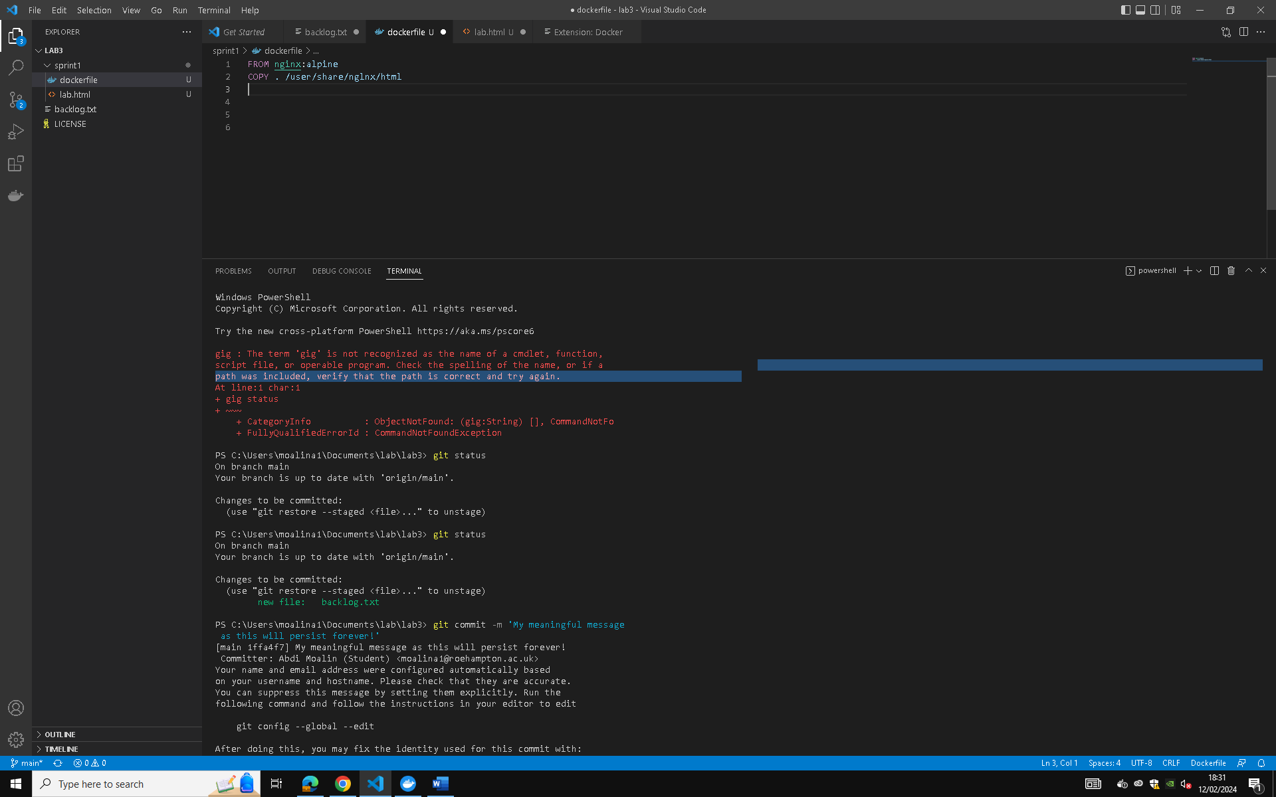
Dockefile in visual studio

Slide 4
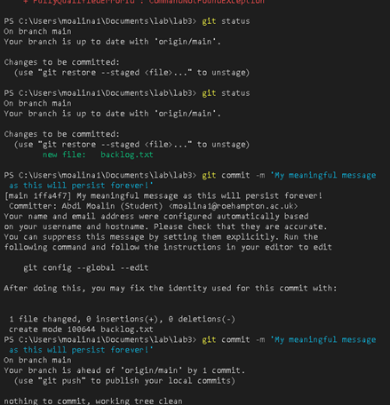
Dockerfile Setup

Slide 5
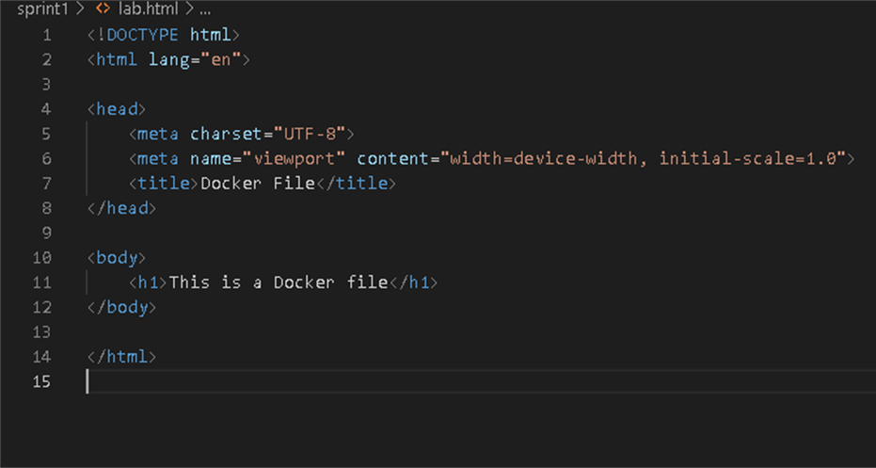
Website Html File

Slide 6
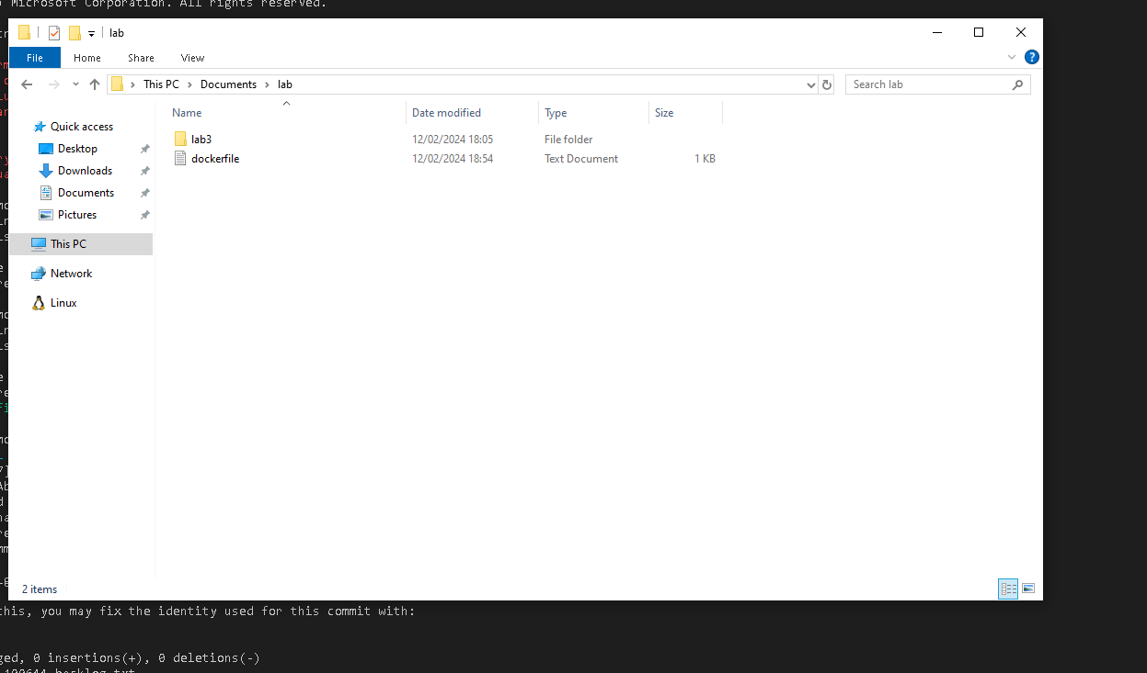
Files saved

